Slide 1
Logic Apps & BizTalk Server 2016
Dan Toomey | Mexia
@daniel2me

Slide 2

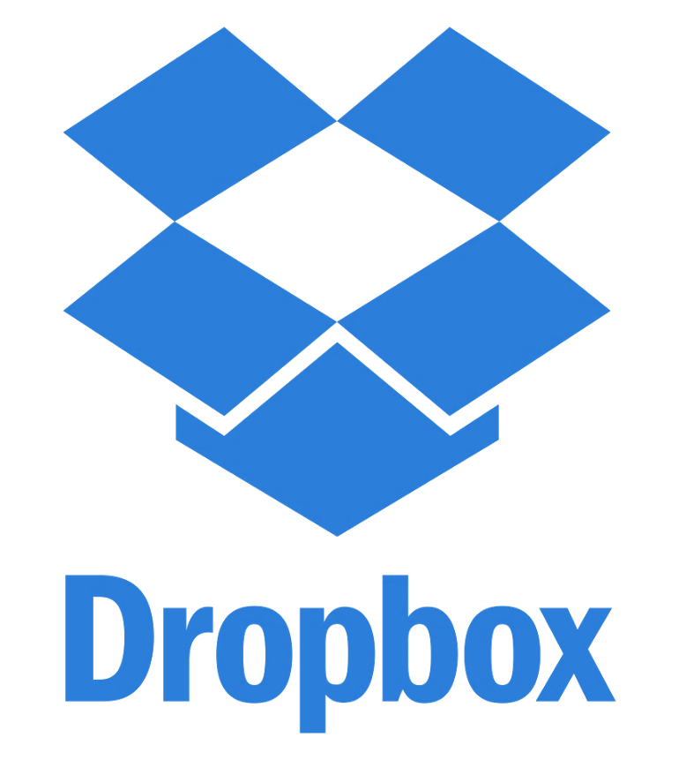
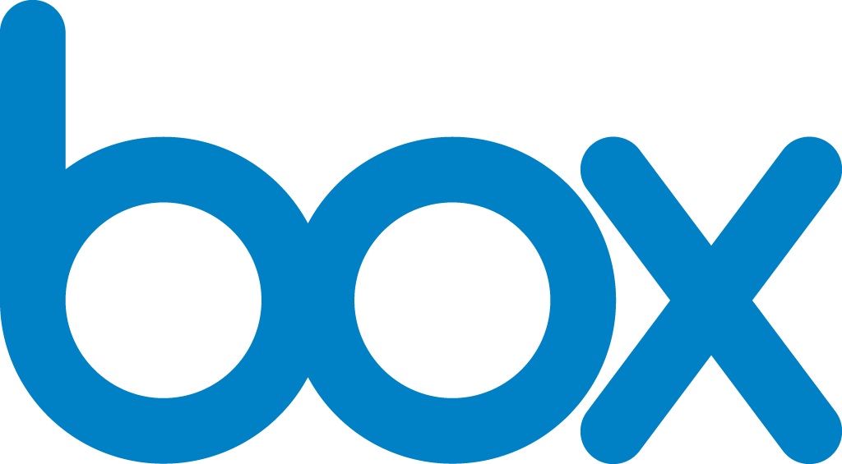
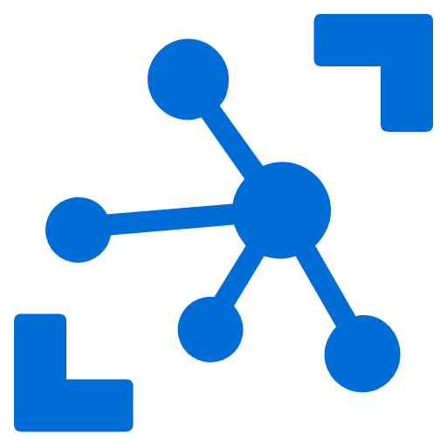
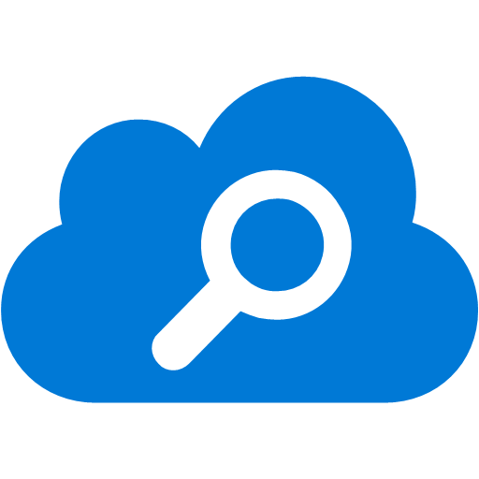

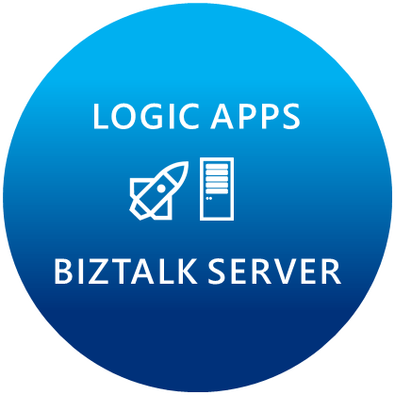
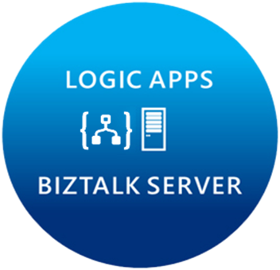


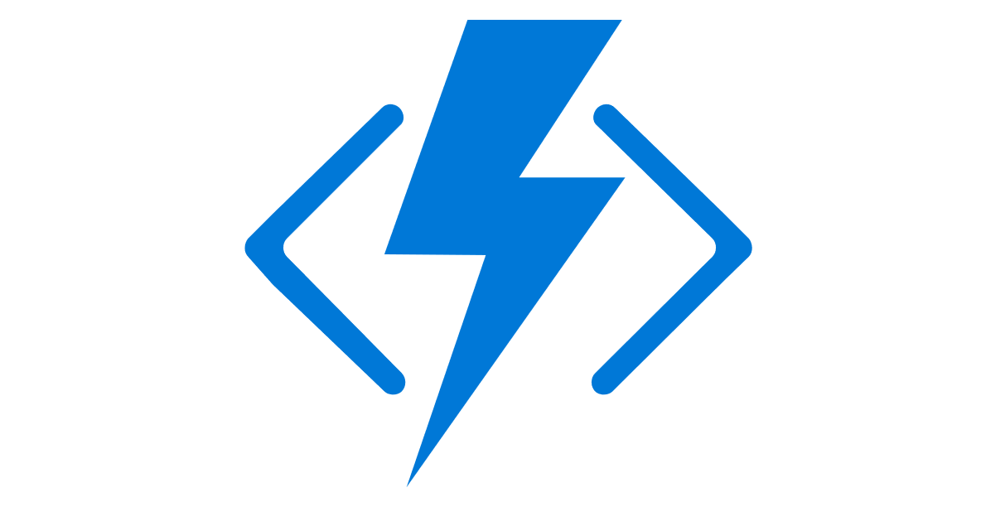


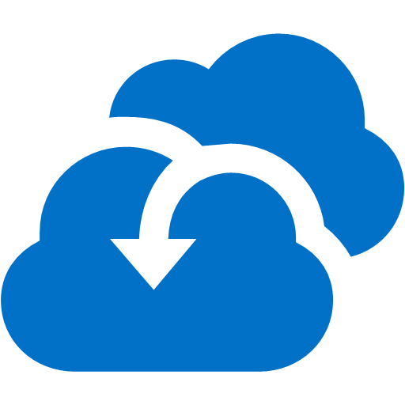

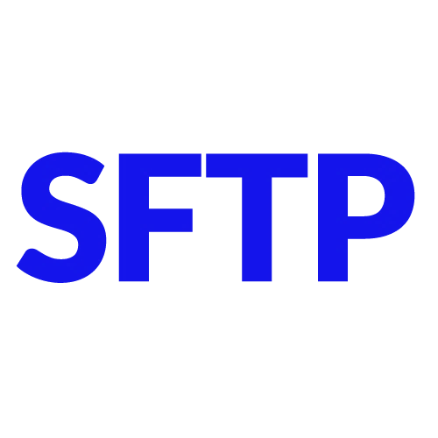

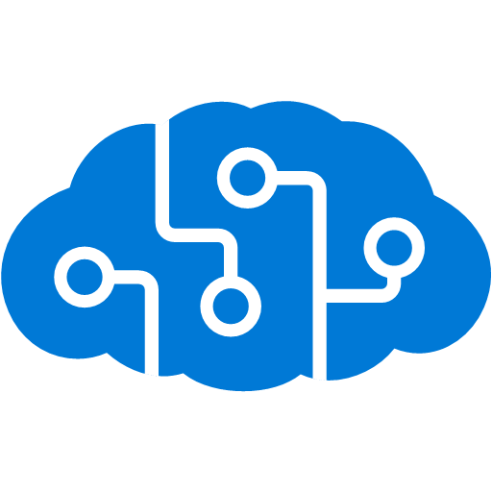
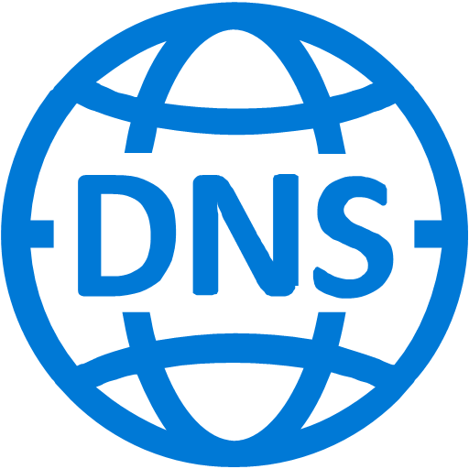

Microsoft’s Hybrid Integration Platform
LOGIC APPS
BIZTALK SERVER
About 39% of developers are focused on building cloud based Application integration
API MANAGEMENT
AZURE SERVICE BUS
IoT/Event Hub
Azure Search
SQL Database
CONNECTORS
AZURE SERVICES
AZURE SERVICE BUS
DocDB
BLOB Storage
Functions
API MANAGMENT
Machine Learning
HD Insight
Site Recovery
B2B/EDI
Tables
Cognitive Services
DNS
Notes:
2 key differentiating factors to highlight again:
Hybrid 2. Azure Services

Slide 3
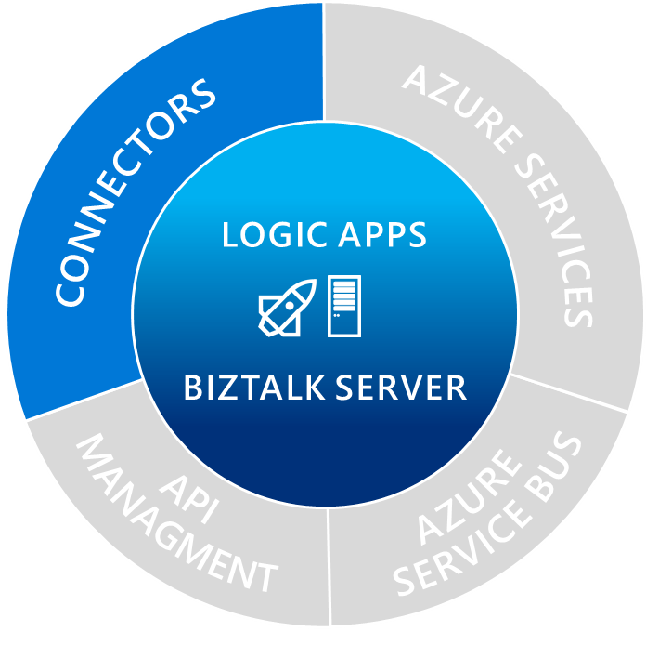
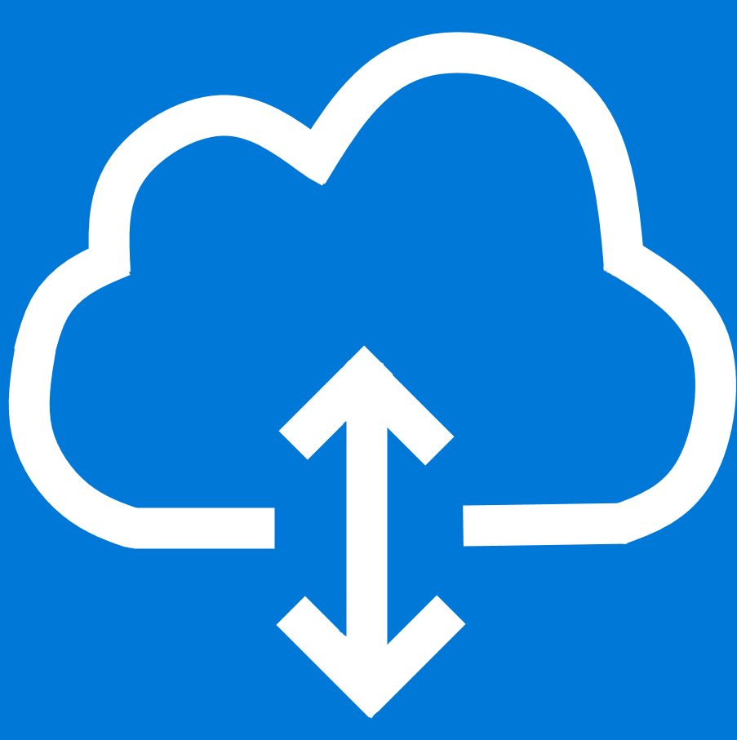
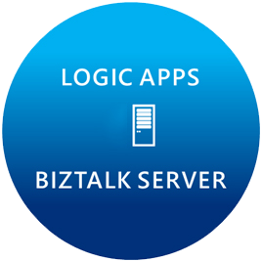

Managed connectors
On-Prem Data Gateway

Slide 4
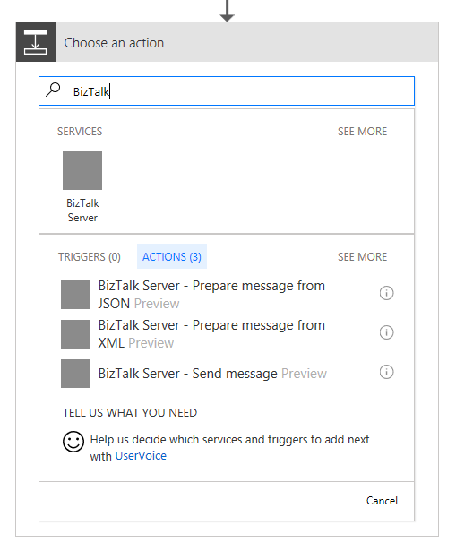
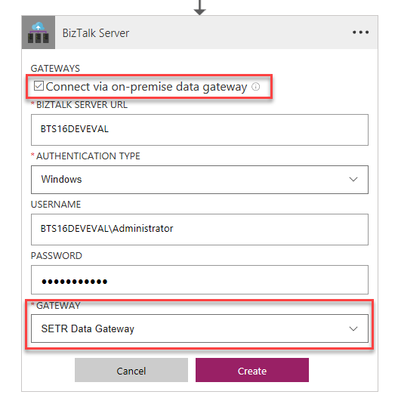
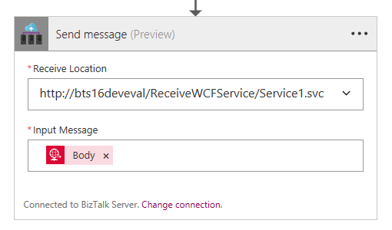
BizTalk Connector
API Connector in Logic App
Uses OPDG
Enumerates schemas and receive locations

Slide 5
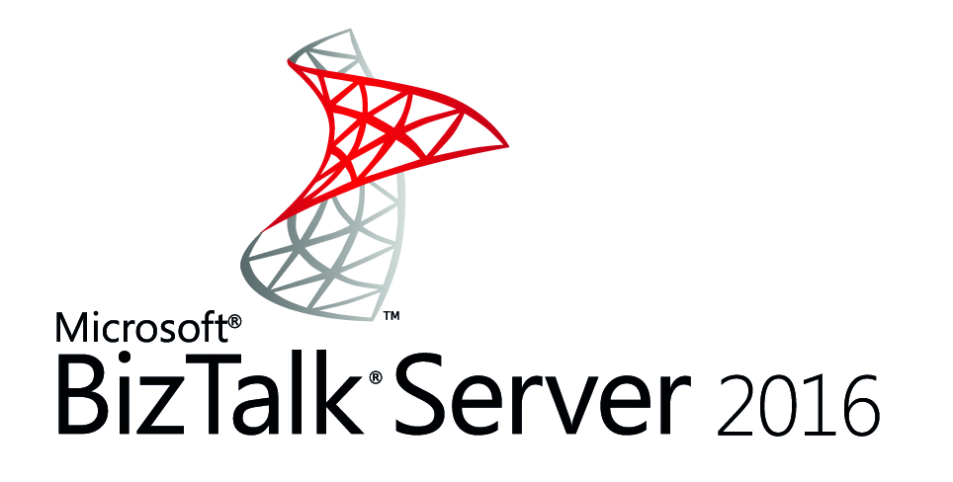

Slide 6
Microsoft BizTalk Server Seamlessly integrate disparate systems and business partners
Hybrid
Customers
Business rules engine
Orchestration
Business activity monitoring
B2B
BizTalk Server
Partners
RFID
SAP
In-house LOB system
IBM mainframe
Siebel
SAP

Slide 7
Microsoft BizTalk Server Seamlessly integrate disparate systems and business partners
Connect any on-premises application
Extend connectivity to the cloud
Go beyond siloed integration
Automate mission critical business processes
B2B/EDI workflows
Message brokering
Business activity monitoring
Connect to cloud applications using Azure Logic Apps Adapter
Adopt cloud on your own pace
Gain insights on your data using Microsoft cloud
Get first class integration with Azure services through the Azure Logic Apps Adapter

Slide 8
Why BizTalk Server 2016?
Support for newer first party platforms
Windows Server 2016
SQL Server 2016
Visual Studio 2015
Office 2016
SQL Server 2016 AlwaysOn availability groups
BizTalk Server Azure VMs in production
New Azure Logic Apps Adapter

Slide 9
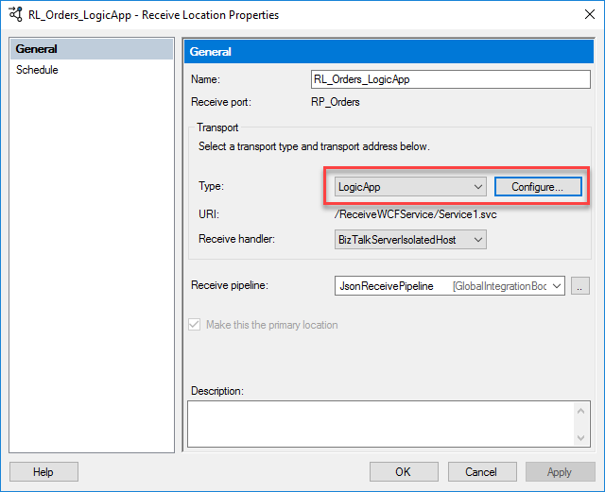
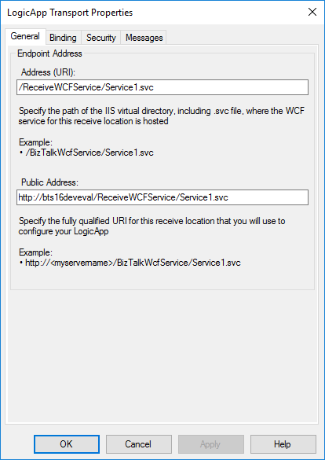
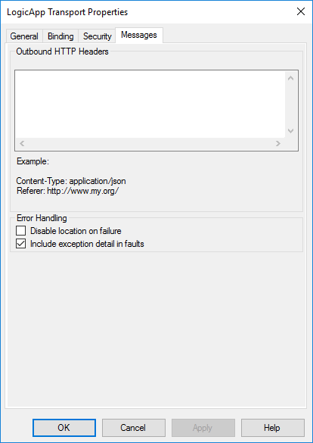
Logic App Adapter – Receive Location

Slide 10
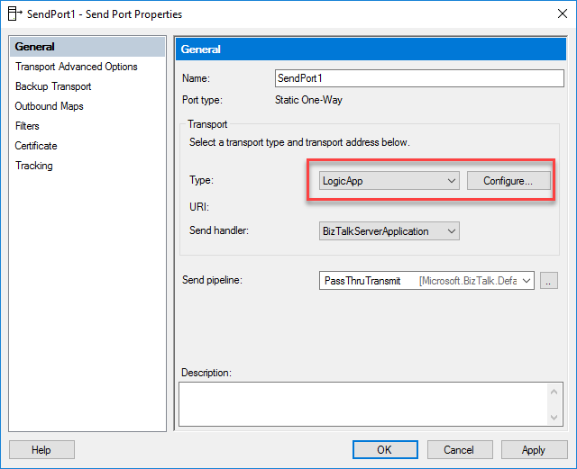
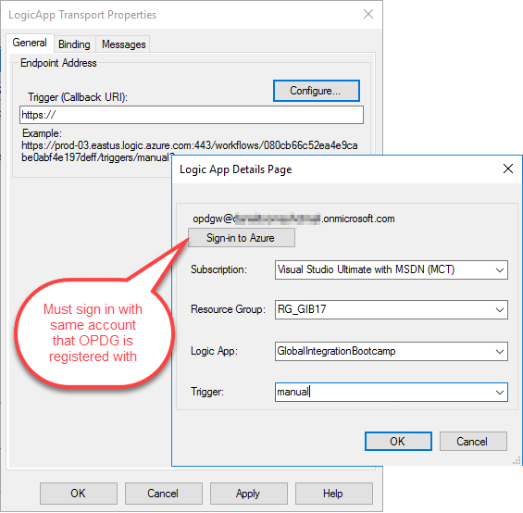
Logic App Adapter – Send Port

Slide 11



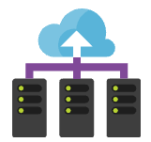
Hybrid Connectivity
SalesForce
SalesForce
Update Trigger
Create in SalesForce
Update
Reply with cust ID
Logic App
Logic App
Yammer
Logic App
Logic App
Yammer
Cloud
On-prem
Order Processing
Orders
Orders
Store order
BizTalk Server 2016
BizTalk Server 2016
Update Customer
Order
Order
Receive a new order
Look up customer
Create Customer
Customers
Update Customer
Customers

Slide 12
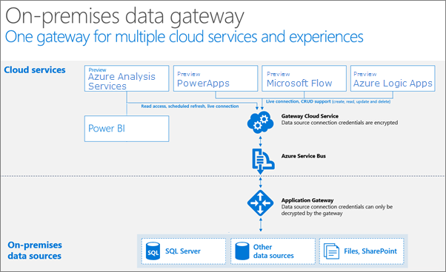
On-Premises Data Gateway
On-prem resources supported:
BizTalk Server
DB2
File System
Informix
MQ
Oracle Database
SAP Application Server
SAP Message Server
SQL Server
Notes:
Remember we talked about the on-prem resources supported? BizTalk Server is one of those resources!

Slide 13
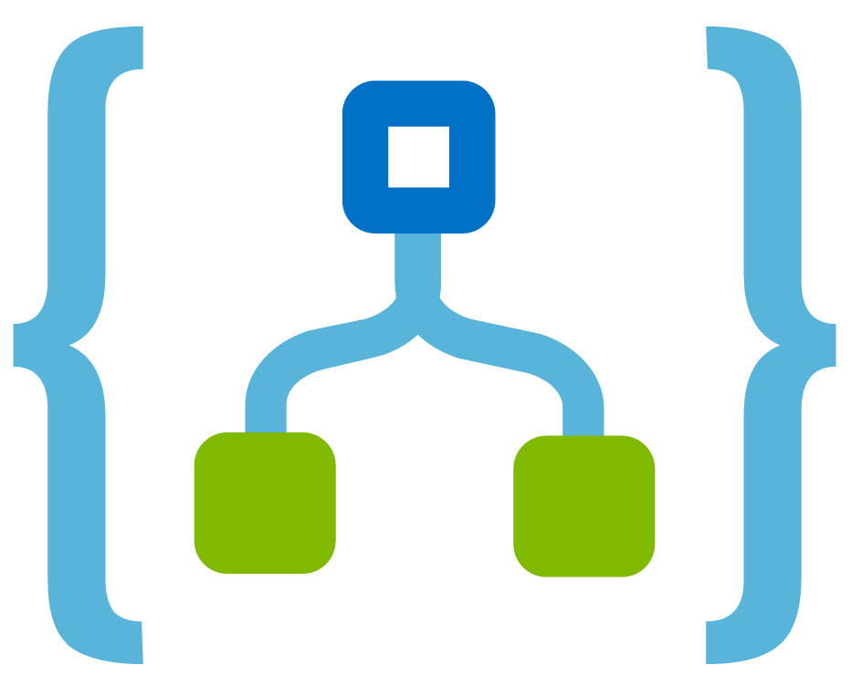
On-Premises Data Gateway
Notes:
From Logic Apps in the cloud to BizTalk Server on-prem, OPDG makes the connection possible.

Slide 14
Azure Service Bus
Publish and subscribe to messages with Topics
Asynchronous messaging over Queues
Read message patterns:
Auto-complete
Peek-lock and complete/abandon
Immediate triggering
High throughput
Notes:
Rob Fox: “The Online Postal Service”

Slide 15

The basics of a queue
Sender sends message to queue
Queue ACKs receipt
Receiver connects to queue & retrieves message
Receiver ACKs complete (or other action)
Sender
Receiver

Slide 16
Topics & Subscriptions
Sender only knows about Topic
Receivers only know about Subscriptions
Filters and Actions exist on Subscriptions
Subscription 1
“type” = “order”
Topic
“type” = “quote”
Subscription 2

Slide 17
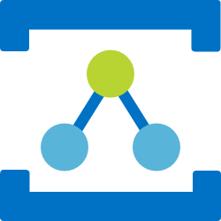
Relay: Real-time communication proxy
The basis of Hybrid Cloud
Used to decouple
Location
Security
VPN and Firewall constraints
✓
Client
Service
Notes:
Michael Stephenson: “A router in the sky”

Slide 18
Bring the cloud to your enterprise with integration
SaaS
apps
Microsoft Azure
Partners
Logic Apps
Service Bus
On-Prem Data Gateway
Applications
Mainframe
Servers
Databases
Notes:
Your business needs to take advantage of the benefits of the cloud such as elastic scale, high availability, global reach, and integration with external applications, but there are parts of your application that must remain on-premises.
The solution is to build a hybrid application composed of some components that run in the cloud and some that run on-premises. Service Bus, Logic Apps and the OPDG make it easy to build applications with API-connected components both in the cloud and on-premises.

Slide 19
Lab #3
Logic Apps + BizTalk Server + Service Bus

Slide 20
Hands-On Lab
Install and configure BizTalk Logic App Adapter
Create Service Bus namespace & topics
Import and configure BizTalk application
Create Azure Logic App
Notes:
Build a VETER pipeline

Slide 21
Questions?

